Slide 1

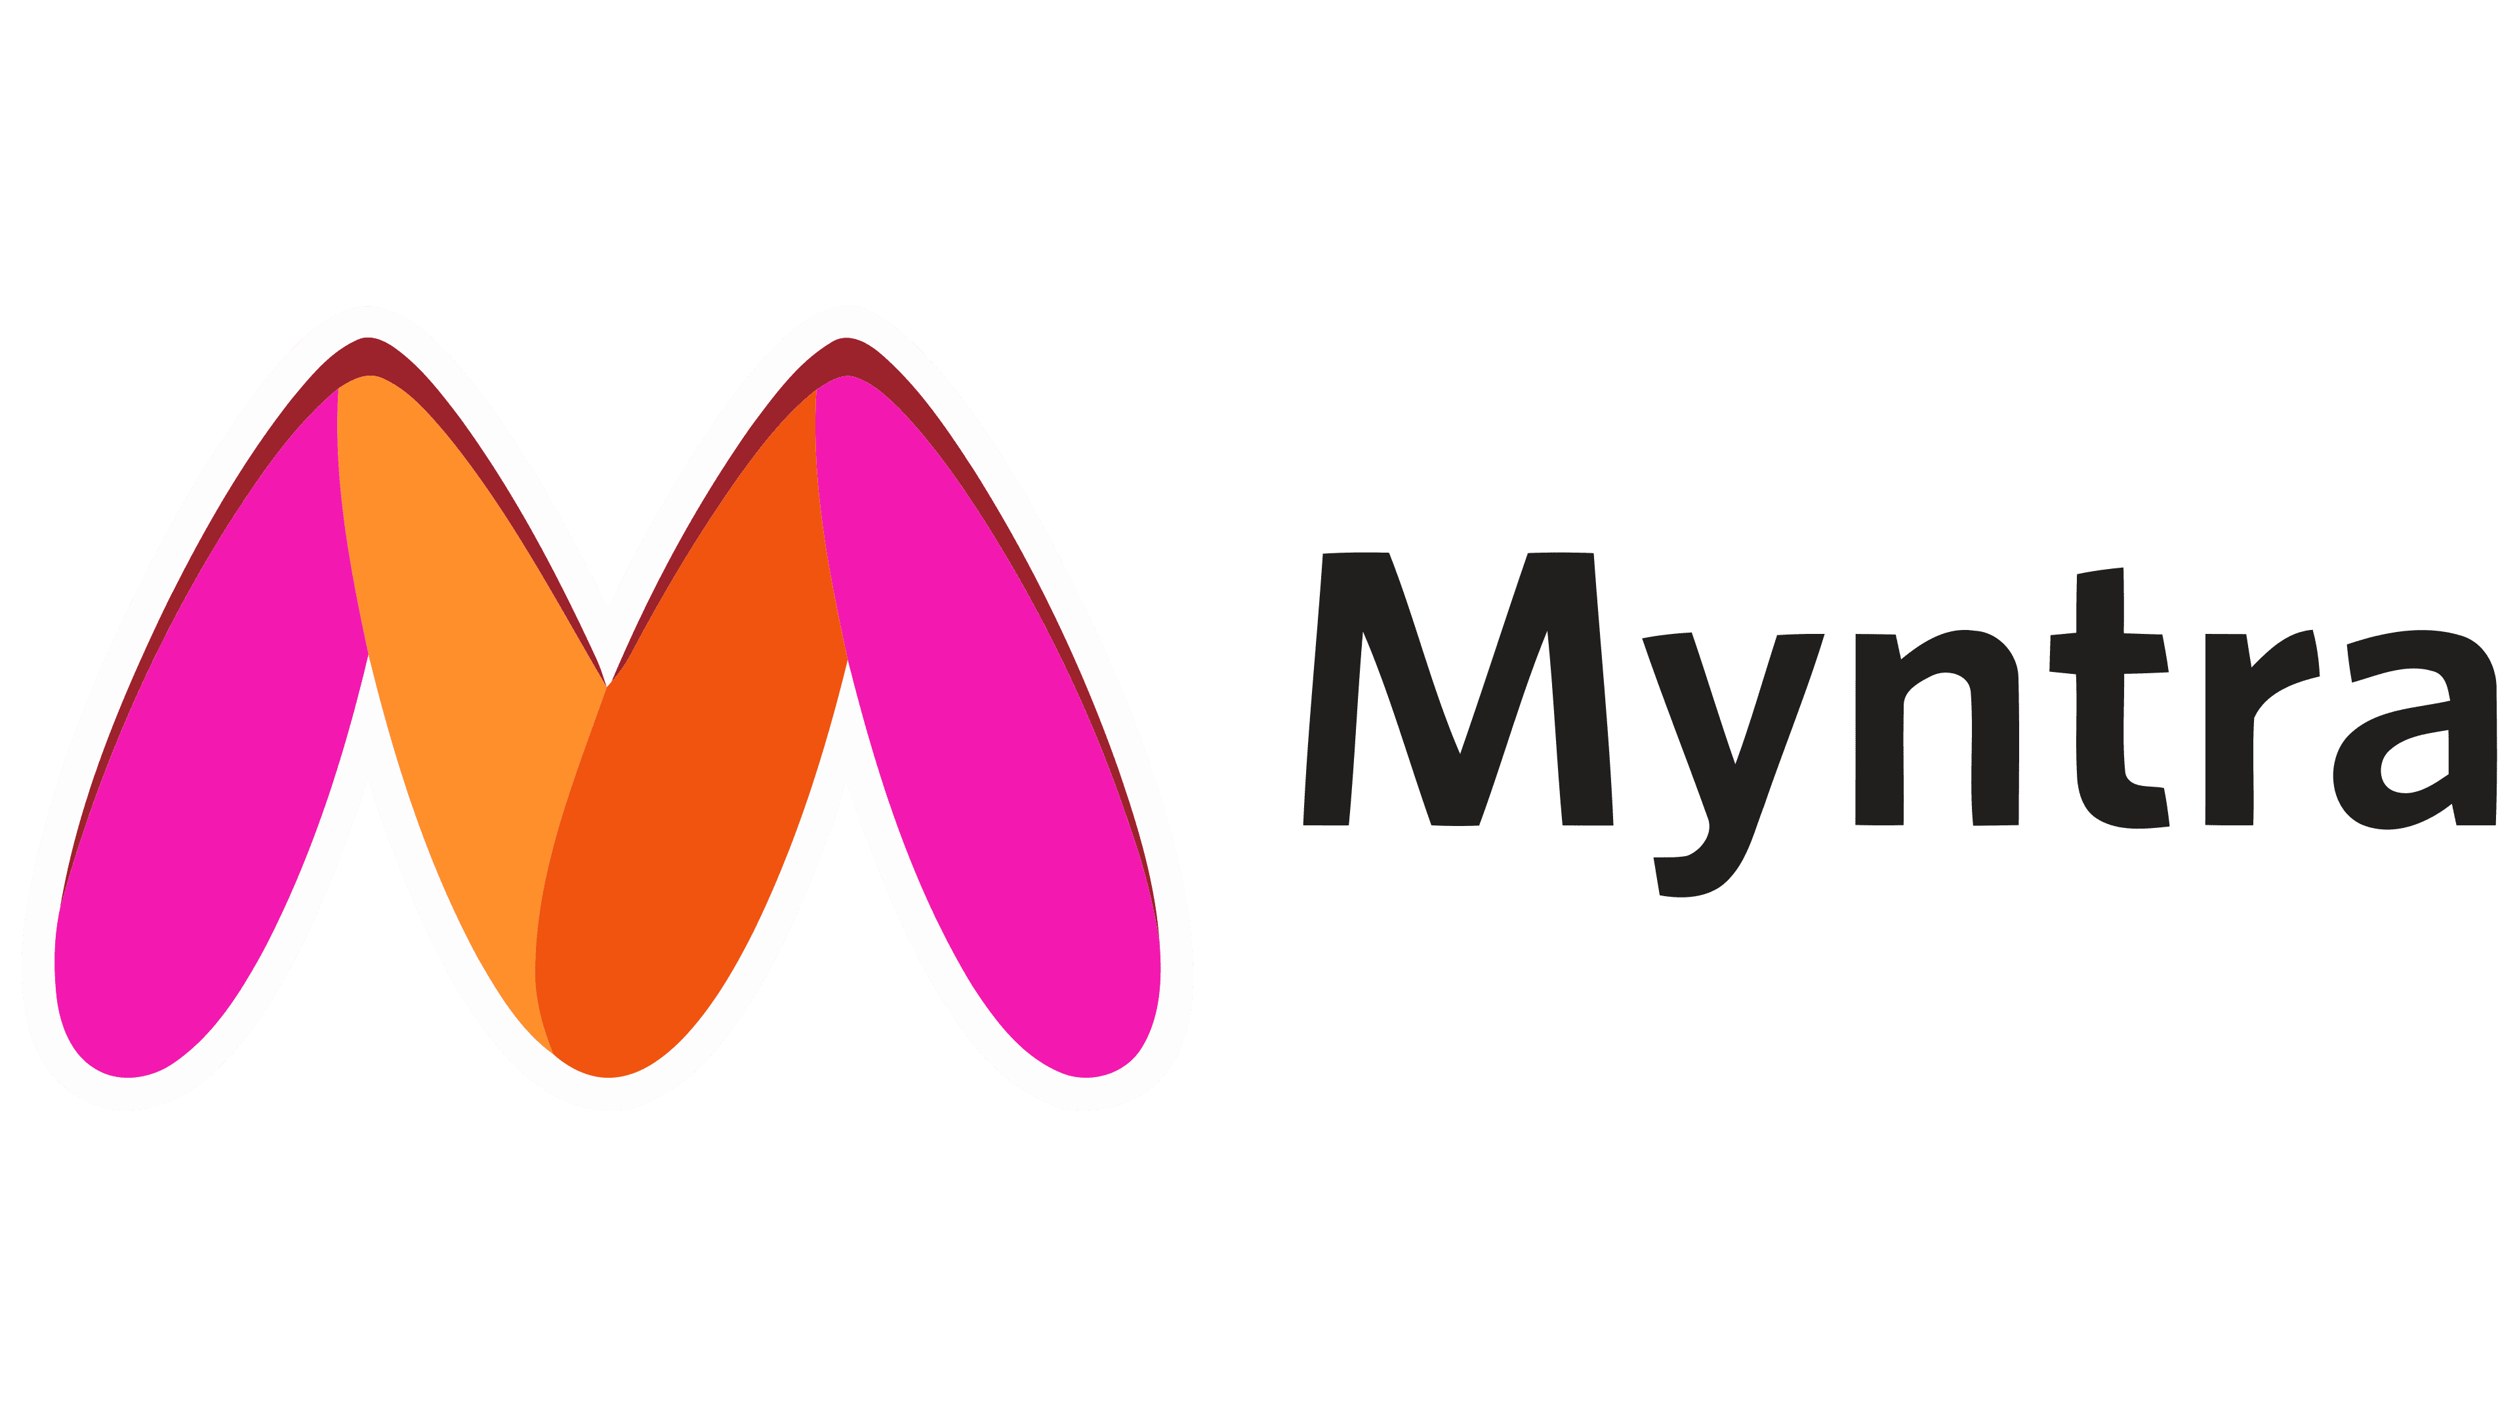
Myntra Analysis…
By,
G. Kiruthik chakra

Slide 2

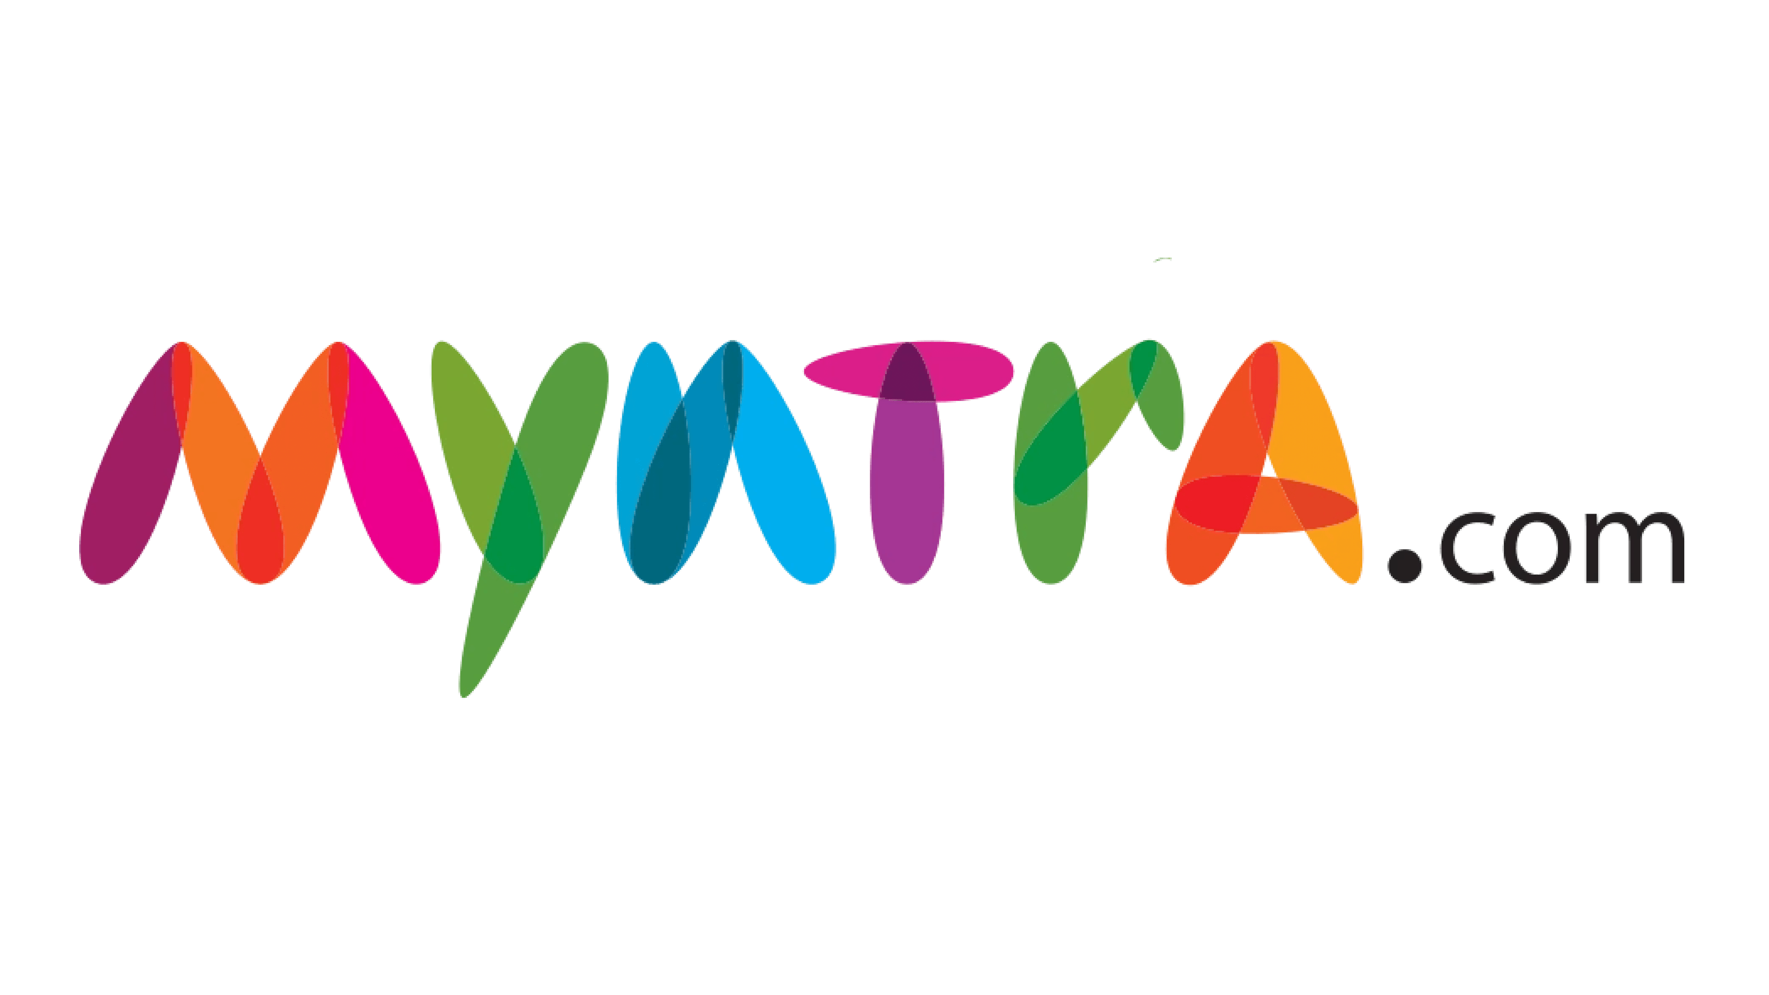
Introduction to Myntra.com
Over view:
Myntra is an Indian e-commerce company that sells fashion and lifestyle products and Founded in 2007–2008 as a B2B venture to sell personalized gifts, Myntra transitioned into a full-fledged e-commerce platform in a few years. In 2014, Flipkart acquired Myntra, and in 2018, it became part of the Walmart Group.
Parent organization: Flipkart
Subsidiaries: Xerion Retail Private Limited.
Founders: Mukesh Bansal, Vineet Saxena, Ashutosh Lawania
CEO: Nandita Sinha.
Mission:
Myntra aims at providing a hassle free and enjoyable shopping experience to shoppers across the country with the widest range of brands and products on its portal. The brand is making a conscious effort to bring the power of fashion to shoppers with an array of the latest and trendiest products available in the country.

Slide 3
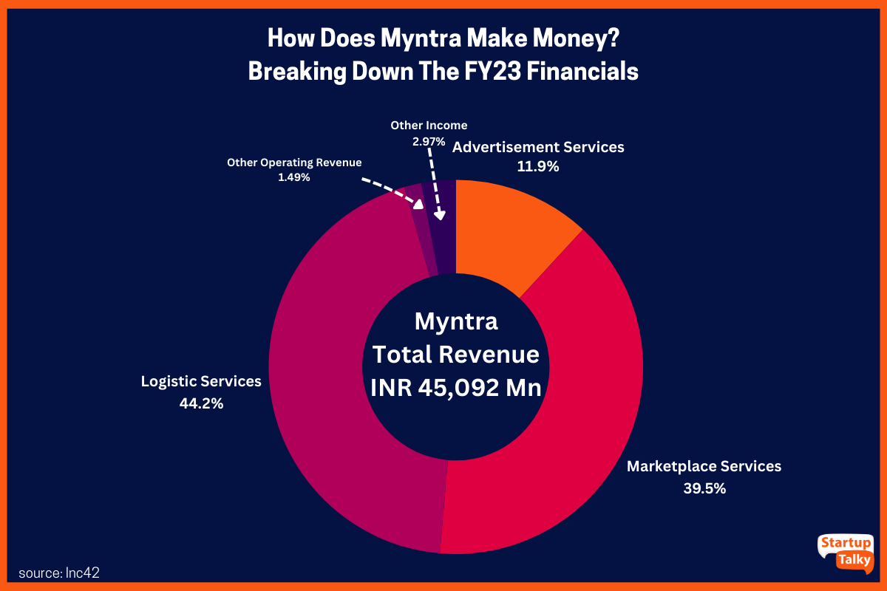
Business Model
According to a report, Myntra generated approximately US$3.9 billion in revenue during the calendar year 2023.
Income for Myntra comes from a variety of sources. A greater sum of money is added to the company's vault through various means, including logistics, advertisements, partnerships, etc.
Logistics: Myntra has established partnerships with numerous organizations to ensure the efficient operation of its logistical chain. The logistical services it offered brought in INR 19,915 million in 2023.
Marketplace Services: As previously mentioned, Myntra is one of the largest fashion marketplaces in the country. The company offers a vast selection of fashion products to its consumers through both its website and app.. In 2023, Myntra generated a gross revenue of INR 17,812 million through marketplace services.
Advertisement: Myntra has become a prominent and preferable location for branding and promotion due to its increasing popularity, which has expanded to the next horizon. In 2023, Myntra generated a total revenue of INR 5,353 million through this approach.

Slide 4
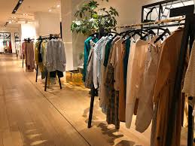








Market Position and Growth
Competes with giants like ajio, meesho, tatacliq ,etsy, nykaa, flipkart.
Market share: Myntra is estimated to have a 35–45% share of India's online fashion market.
User base: Myntra has over 60 million monthly active users, a 33% increase from 2021.
Myntra's growth is driven by:
Customer acquisition: Myntra has seen strong growth due to customer acquisition.
Fashion and lifestyle needs: Myntra is committed to solving the beauty and fashion needs of the country.
Innovation: Myntra has invested in the right growth engines.

Slide 5
Growth Trajectory
1.Early Years and Foundation (2007–2010)
Founded in 2007 by Mukesh Bansal, Myntra initially operated as a B2B platform focused on personalized gifting (custom t-shirts, mugs, etc.).
By 2010, it pivoted to become a B2C fashion e-commerce platform, capitalizing on the growing demand for online shopping in India.
4. Growth Through Festive Sales and Innovations (2015–2017)
End of Reason Sale (EORS): Myntra introduced EORS, one of the largest fashion sales in India, significantly boosting revenue and customer acquisition.
5. Walmart’s Entry and Market Leadership (2018–2019)
Flipkart (and Myntra) was acquired by Walmart in 2018, marking Myntra’s entry into a global retail ecosystem.
2.Expansion and Brand Partnerships (2011–2014)
Key Partnerships: Myntra partnered with major Indian and international fashion brands, expanding its portfolio to include clothing, footwear, and accessories.
6. Pandemic Boom and Digital Acceleration (2020–2021)
COVID-19 Pandemic: Lockdowns led to a surge in online shopping, and Myntra capitalized by enhancing its digital presence and expanding categories such as loungewear and activewear.
3. Flipkart Acquisition and Consolidation (2014)
Acquired by Flipkart in 2014 for approximately $300 million, enabling Myntra to leverage Flipkart’s logistics, technology, and customer base.
7. Recent Developments and Diversification (2022–2024)
Sustainability Initiatives: Myntra introduced eco-friendly collections and adopted green practices in logistics.
Influencer Collaborations and Live Shopping: Strengthened its marketing through partnerships with social media influencers and live-streaming platforms.

Slide 6






Myntra Revenue Model..
Myntra makes revenue from different resources some of which are listed below:
.
Commission Fees: Depending on the product's category and brand, Myntra's primary revenue stream is the charging of a predetermined fee, which normally ranges from 4% to 5%.
Marketplace Services: Myntra makes money by giving different brands and merchants a place to display and sell their goods on its online marketplace.
Logistics Services: By making it easier for clients to store, package, and receive things, the company makes money through its logistics services.
Advertisement: Myntra makes use of its platform to facilitate the promotion of brands' items to a broad audience, generating extra income.
Other Resources: To maintain a diversified and long-lasting financial strategy, Myntra investigates and makes money from several additional sources in addition to the main revenue streams.

Slide 7
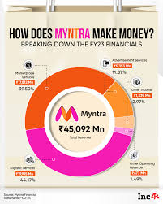
Myntra Marketplace Revenue 2023
Marketplace Services:39.5%
Logistics services:44.2%
Advertisement services:11.9%
Other operating Revenue:1.49%
Other Income:2.97%

Slide 8
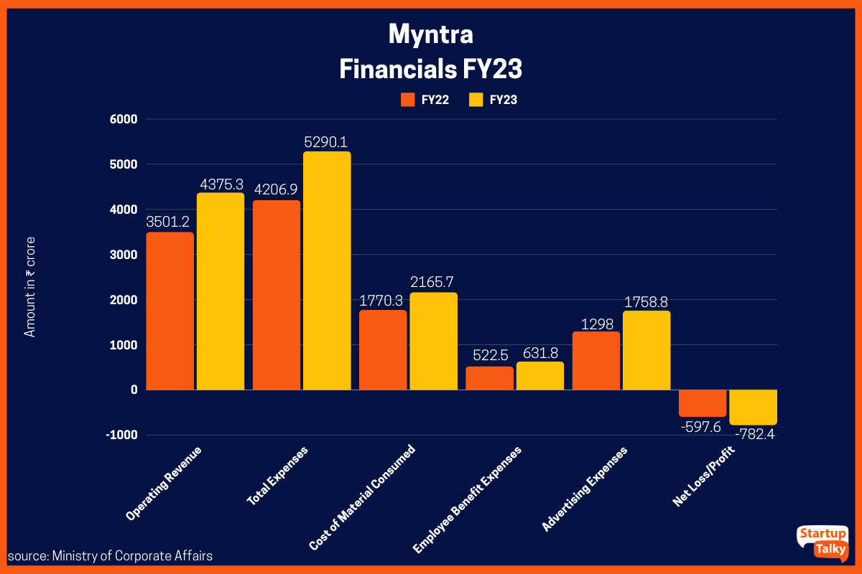
Myntra Financials
Myntra Financials | FY22 | FY23
Operating Revenue | INR 3501.2 crore | INR 4375.3 crore
Total Expenses | INR 4206.9 crore | INR 5290.1 crore
Cost of Material Consumed | INR 1770.3 crore | INR 2165.7 crore
Employee Benefit Expenses | INR 522.5 crore | INR 631.8 crore
Advertising Expenses | INR 1298 crore | INR 1758.8 crore
Net Loss/Profit | Loss of INR 597.6 crore | Loss of INR 782.4 crore

Slide 9
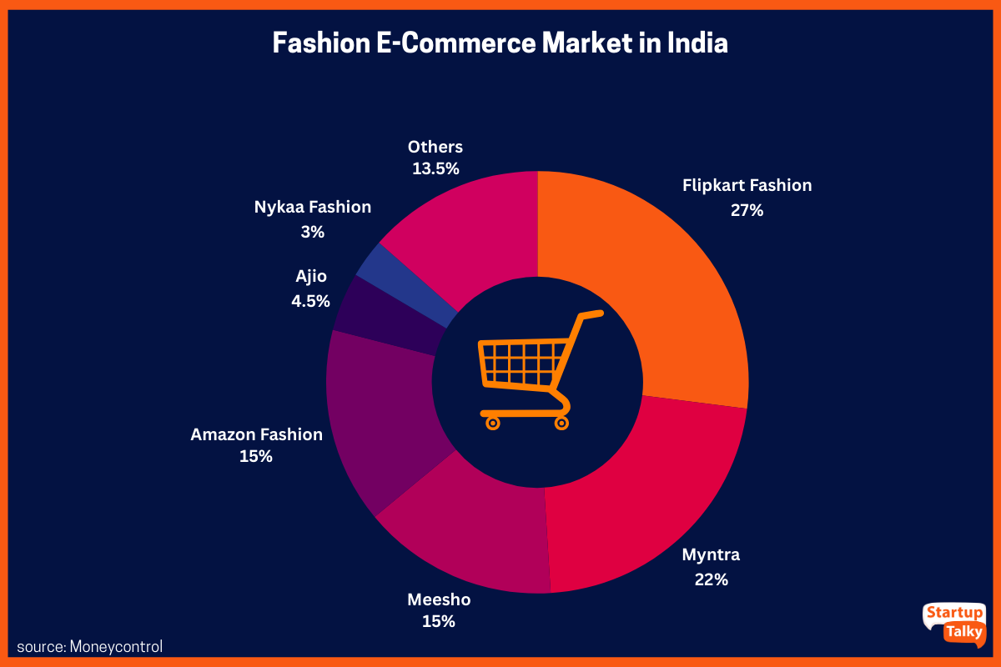
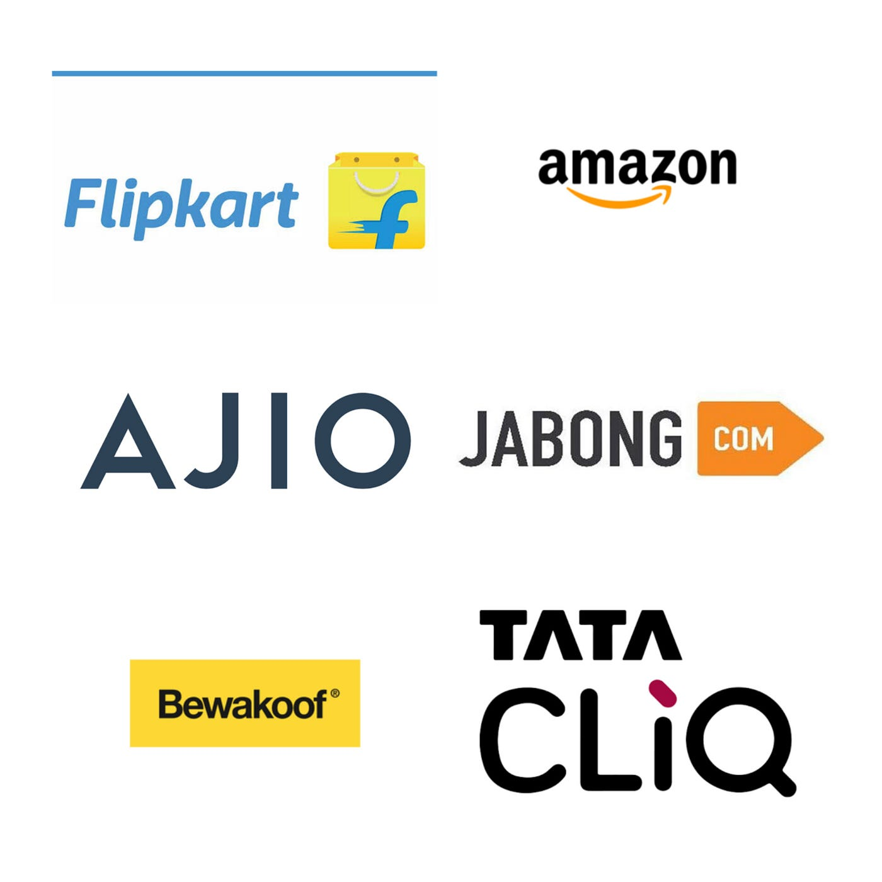
Comparable online store of myntra.com in fashion products in india..
Some of Myntra's competitors include:
Amazon and Flipkart: Direct competitors
AJIO and Koovs: Big brands resellers
Puma and Nike: Private labels
Meesho,GlowRoad,Bulbul, and Offline Fashion: Marketplace competitors
Tatacliq.com and hm.com: Competitors to ajio.com

Slide 10
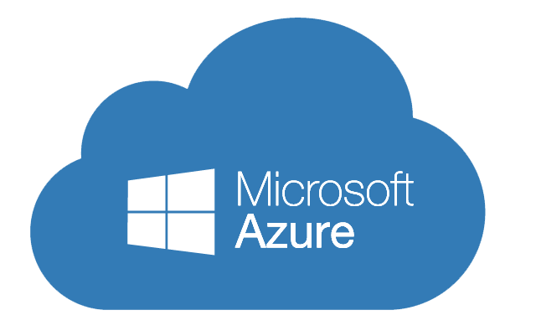

Technology utilization
cloud services:
Myntra uses Microsoft Azure Cloud Platform for its cloud services:
Scalability: Myntra uses Azure Synapse Analytics and Azure HDInsight to scale up during sale events and increase traffic.
Data analysis: Myntra uses Azure's AI and data capabilities to better understand customers and deliver personalized products and marketing.
Cost-effective computing: Myntra uses Azure for cost-effective computing.
Secure environment: Myntra uses Azure to scale its technology in a secure environment.
Impact of Technology:
1.AI/ML for Personalization:
Real-time personalized product recommendations based on user behavior and preferences.
Tailored homepages and customized search results enhance user engagement.
2.Augmented Reality (AR) and Virtual Try-On:
AR tools for virtual try-ons improve the pre-purchase experience for products like sunglasses, makeup, and more.
Size recommendation engines reduce return rates.

Slide 11
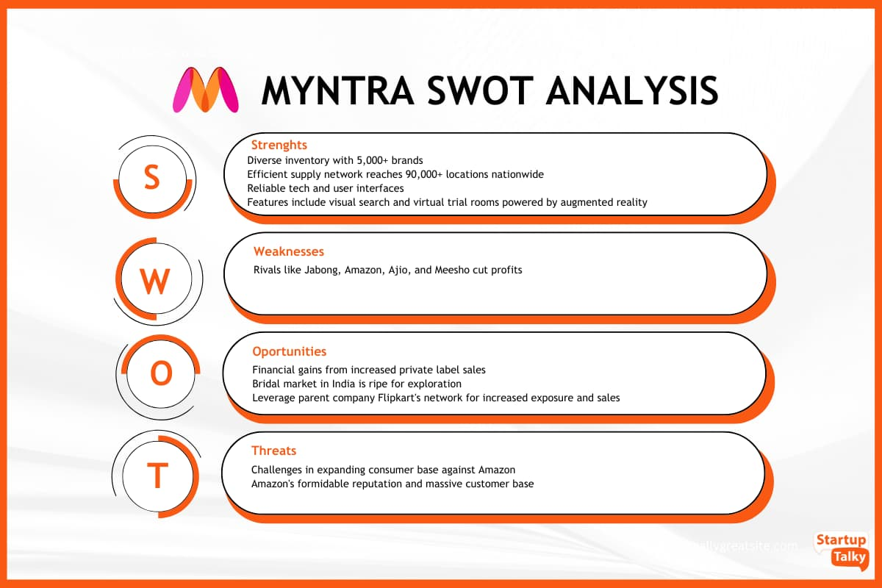
SWOT ANANLYSIS OF MYNTRA
1.Myntra Strengths
The platform offers a huge product inventory with more than 5,000 brands.
The company's supply network reaches over 90,000 locations nationwide.
2.Myntra Weakness
Rival brands such as Jabong, Amazon, Ajio, and Meesho cut into its profits and market share.
3.Myntra Opportunities
The company stands to gain financially from an increase in private label sales.
The bridal market in India
4.Myntra Threats
Myntra may face challenges in expanding its consumer base in the face of Amazon's formidable reputation and massive customer base.

Slide 12








Customer analysis using YouTube comments with ChatGPT..
Customer Review Analysis
Methodology:
Analyzed social media platforms twitter, Instagram , Facebook and reviews sites like in trust pilot, google reviews and YouTube reviews.
Categorized reviews into High impact , Middle impact and Low impact.
Findings :
High impact reviews : praise for product quality and variety.
Low impact reviews: Issues with delivery items and customer service

Slide 13


High Impact Consumer Comments..
1.Great Product Quality:
Myntra never disappoints with quality. The products are exactly as shown, and I’m always impressed with their durability."
2.Fast and Reliable Delivery:
I love how quickly Myntra delivers, even during big sales. It’s super convenient!"
3.Wide Range of Brands and Styles:
Myntra has an amazing collection of both premium and budget-friendly brands. It’s my one-stop shop for all occasions."
4.Easy Returns and Refunds:
The return process was so smooth. Myntra picked up the item the next day, and I got my refund in just a few days!"
5.Effective Personalization:
The recommendations are spot on! I always find products that match my style."

Slide 14


Low Impact Consumer Comments..
1.Inconsistent Sizing:
"The sizing can be a hit or miss. Sometimes the same size fits differently for different brands.“
2.Product Not as Expected:
"The product looked different in the images. It wasn’t the color or texture I expected.“
3.Delayed Customer Support:
"I had an issue with my order, but it took too long to get a resolution from customer care.“
4.Discounts Not Always Accurate:
"The discount shown during checkout didn’t apply properly. I ended up paying more than expected.“
5.Delivery Delays During Sales:
"My order was delayed during the Big Fashion Sale, and tracking updates weren’t helpful."

Slide 15
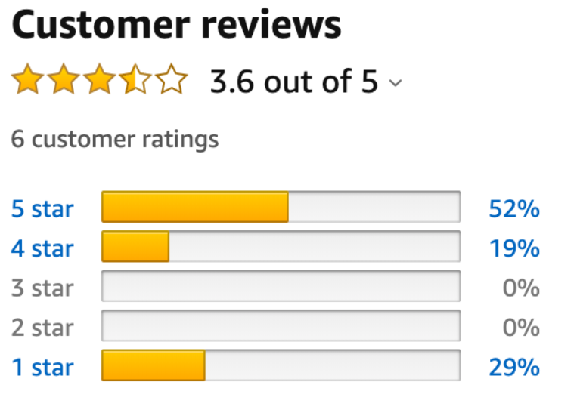

Medium Impact Consumer Comments..
Decent Offers During Sales
"The discounts during sales are good, but not always the lowest compared to other platforms.“
User-Friendly App
"The app is easy to use, and I like how I can filter products quickly. But sometimes it lags during sales.“
Packaging Quality
"The packaging is neat and secure, though I feel it could be more eco-friendly.
4.Moderate Delivery Speed
"Delivery is usually on time, but sometimes it takes longer than expected even when I’m in a metro city.“
5.Product Quality Varies Across Brands
"Some brands are amazing, but others don't meet expectations. Myntra should curate better."

Slide 16
Myntra Competitors In May-2024
List of myntra.com competitors in October 2024:
ajio.com, with 22.1M visits, 79 authority score, 55.75% bounce rate
meesho.com, with 47.37M visits, 76 authority score, 44.91% bounce rate
tatacliq.com, with 8.43M visits, 64 authority score, 59.11% bounce rate
etsy.com, with 422.79M visits, 100 authority score, 47.69% bounce rate
nykaa.com, with 11.29M visits, 74 authority score, 55.79% bounce rate
flipkart.com, with 305M visits, 97 authority score, 48.72% bounce rate
jiomart.com, with 15.57M visits, 74 authority score, 48.9% bounce rate

Slide 17
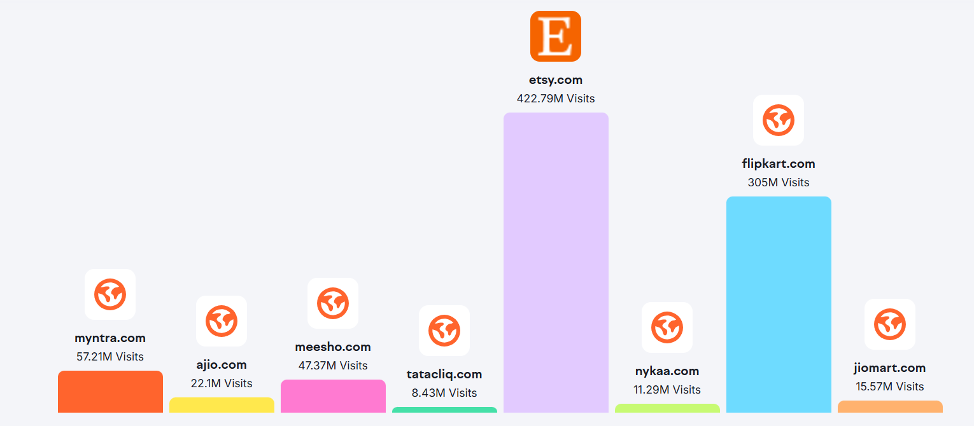
Comparison of Monthly Visits: myntra.com vs Competitors, October 2024..

Slide 18
Competitive Analysis..
Competitors are:
ajio.com
meesho.com
tatacliq.com
etsy.com
nykaa.com
flipkart.com
jiomart.com
Comparison Factors :
Product Range and Quality
Pricing strategies
Customer Service Ratings
Social Media Presence and Engagement
Brand Partnerships
Pricing Discounts
Delivery and Logistics
Competitive Advantage :
Focus on Trendy and curated collections.
Strong focus on Fashion Lifestyle
Exclusive Brand Partnerships and Private Labels.
Myntra Insider Loyalty Program.
Strong Brand Presence.
Robust Sales Events.

Slide 19

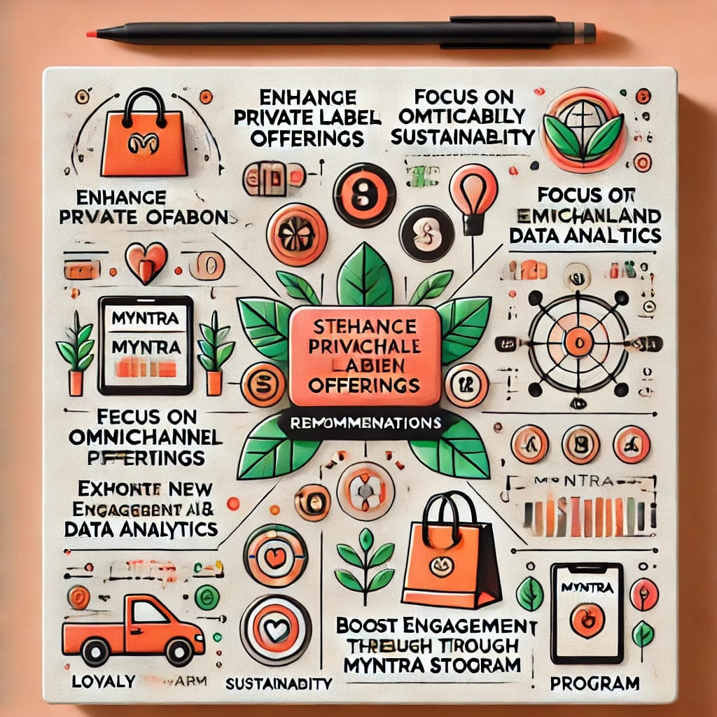




Strategic Recommendations..
Enhance private label offerings.
Strengthen Omnichannel Presence.
Focus On Sustainability.
Leverage AI and Data Analytics.
Expand into New Categories.

Slide 20



Websites used For Analysis..
Finding detailed rankings and competitors and web traffic using this website:
https://www.semrush.com/website/myntra.com/competitors/#competitors
For Detailed Competitor Analysis:
https://www.similarweb.com/website/myntra.com/
Myntra Financials Analysis:
https://startuptalky.com/myntra-online-fashion-store/

Slide 21
Conclusion: Due to the extreme nature of Myntra's business strategy, the company has been able to influence the fashion trend through the use of a variety of marketing methods. Myntra's business model has seen amazing development, which has resulted in the establishment of a prominent and actively developing eCommerce sector.

